Slide 1


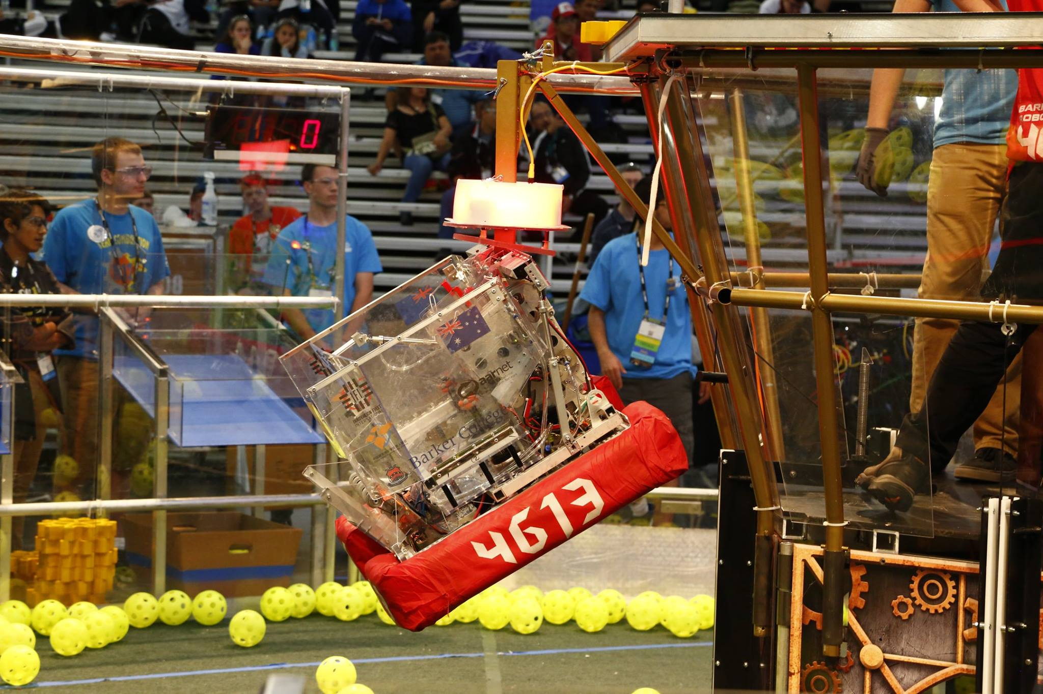
Introduction to (Java) Programming – 2.4 – Control Flow
Tom Schwarz

Slide 2
Lesson 5: Control Flow
Currently your programs have done the same thing each time. But, with this lesson, we’ll learn how to have your code make decisions.
If statements. If statements let you run code only if something evaluates to be true. For example:
int bestestNumber = 8;_ _ if (bestestNumber > 5) {_ _ System.out.println("BestesetNumbers is greater than 5"); _ } _

Slide 3
Lesson 5: Control Flow
if (statement here evaluates to true or fale) {_ _ // Runs if true }
The bit inside the brackets (that is evaluated) could be a condition or a Boolean
Conditionals:
Operator | What it does | Example
== | equal to | (2 == 2)
!= | not equal to | (3 != 4)
> | Greater than | (5 > 3)
>= | Greater than or equal to | (2 >= 2)
< | Less than | ( 1 < 3)
<= | Less than or equal to | (3 <= 3)

Slide 4
Lesson 5: Control Flow
Comparing Strings – Because of Java funkiness, the “==“ operator dosen’t work for Strings. Instead use .equals() – see the following:
String bestestVegetable = "potato"; _ if (bestestVegetable == "potato") { _ //This evaluates to false! Yes it is stupid. yay java. } if (bestestVegetable.equals("potato")) { _ //This however will evaluate to be true, and so the following code will run. _ System.out.println("All Hail Lord Potato"); _ } _

Slide 5
Lesson 5: Control Flow
You can also have your code make decisions based on several evaluations, using and & or
And – written as && in code, only gives true if both statements it connects are true
Or – written as || (Shift+Backslash, called a pipe) in code, gives true if either statements are true
int value1 = 1; _ int value2 = 2; _ if ((value1 == 1) && (value2 == 2)) { _ System.out.println("value1 is 1 AND value2 is 2"); _ } _ if ((value1 == 1) || (value2 == 1)) { _ System.out.println("value1 is 1 OR value2 is 1"); _ } _
Note that you can chain statements together, and they evaluate using BODMAS bracket rules. So if ( (1==1) && ( (1<=0) || (2==2) ) ) gives true and executes.

Slide 6
Lesson 5: Control Flow
If / Else if / Else statements let you do various actions based on the conditional.
int weAre = 1; _ _ if (weAre == 1) { _ System.out.println("Here's a lesson in Trickery"); _ } else if (weAre <= 10) { _ System.out.println("jk nevermind no lesson 2day"); _ } else { _ System.out.println("Oh noes."); _ } _

Slide 7
Lesson 5: Control Flow
Switch statements let you do things based on many different options. Eg:
int month = 8; _ String monthString; _ _ switch (month) { _ case 1: monthString = "January"; _ break; _ case 8: monthString = "August"; _ break; _ case 10: monthString = "October"; _ break; _ default: monthString = "Invalid month"; _ break; _ } _ System.out.println(monthString); _
This would give “August” as it’s month
(I cut out some of the mounts so it could fit on the slide)
You can also do Switchs on Strings, and Enumerations which are fancy and covered later.

Slide 8
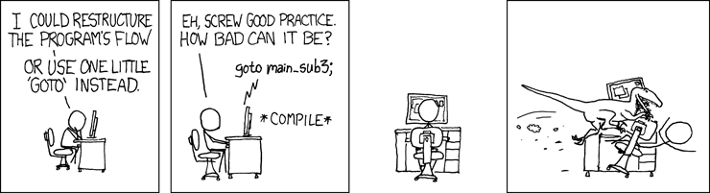
Lesson 5: Control Flow
Yay you’re done! Now read the guide and do the activities - https://github.com/Team4613-BarkerRedbacks/Programming-Java-Guide/blob/master/2.Core-elements-of-programs/2.4.Control-Flow.md
We haven’t covered goto’s (or breaks and continues). The short is, don’t use them. The long is, if you use them you will regret it. They’re alternative ways to do control flow stuff.

